Slide 1


Pitch Template

Slide 2

aBOUT TEAM

Slide 3
ABOUT US
Team : OR Experts
We are OR Experts who loves to solve challenging business problems
Team members:
Rishikesh Kushwaha
Rahul Sawant
Inspiration:
The world faces an ever-increasing need for sustainable energy sources to combat climate change and reduce our dependence on finite fossil fuels.
This hackathon aims at leveraging steps towards sustainable energy using data analytics and advance data science techniques. This inspires us to use our skills in shaping sustainable future.
Skill sets:
We are involved in development and deployments of products using advance data analytics. We have deployed products which are used in industries for their operational benefits.
Using skills from machine learning and operation research we can help accelerate energy transition.
Notes:
Be holistic while answering the points highlighted in the slide. This slide does not hold any score weightage

Slide 4
Proof of methodology

Slide 5
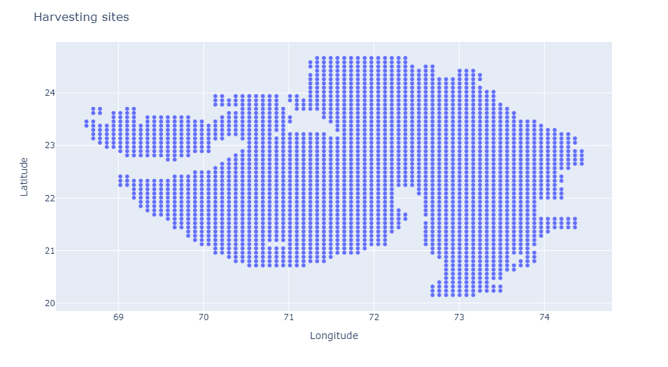
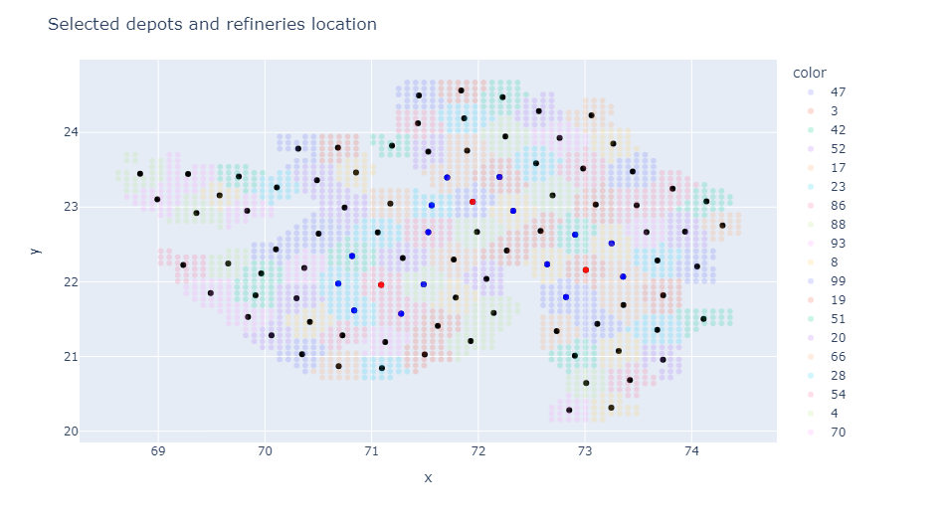
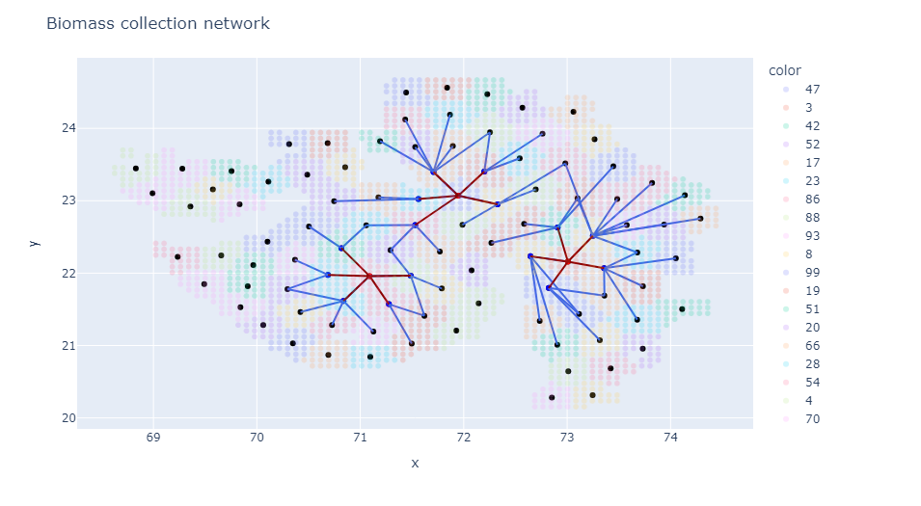
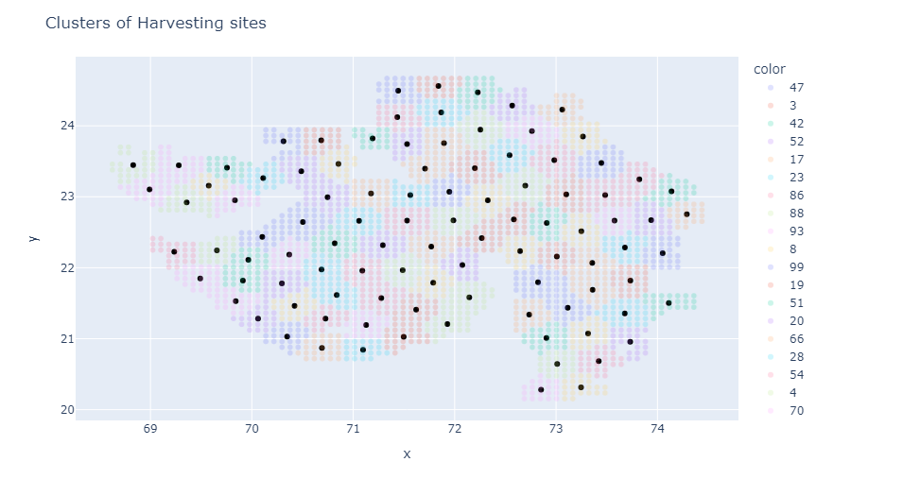
Framework for solution
Biomass Production Forecasting
Biomass production forecasting
Location based clustering
Location based clustering
Facility location problem for clusters
Facility location problem for clusters
Facility location problem for all locations
Supply chain network problem for all locations
Time series forecasting for each harvesting site
Tools : FB Prophet, ARIMA, SARIMAX
Output : Biomass forecast value for each harvesting site for each year
Clustering to group all sites into predefined clusters
Tools : k- means clustering, Python
Output : Clusters of harvesting sites with aggregated biomass forecasts at cluster centroids
Solving facility location problem for clusters with aggregated biomass forecasts for each year
Tools : Mixed integer programming, pyomo, gurobi
Output : Depots and refineries locations
Solving supply chain network problem for all harvesting sites and fixed depots and refineries for each year
Tools : Mixed integer programming, pyomo, gurobi
Output : Biomass and pellet flow in supply chain for each year

Slide 6
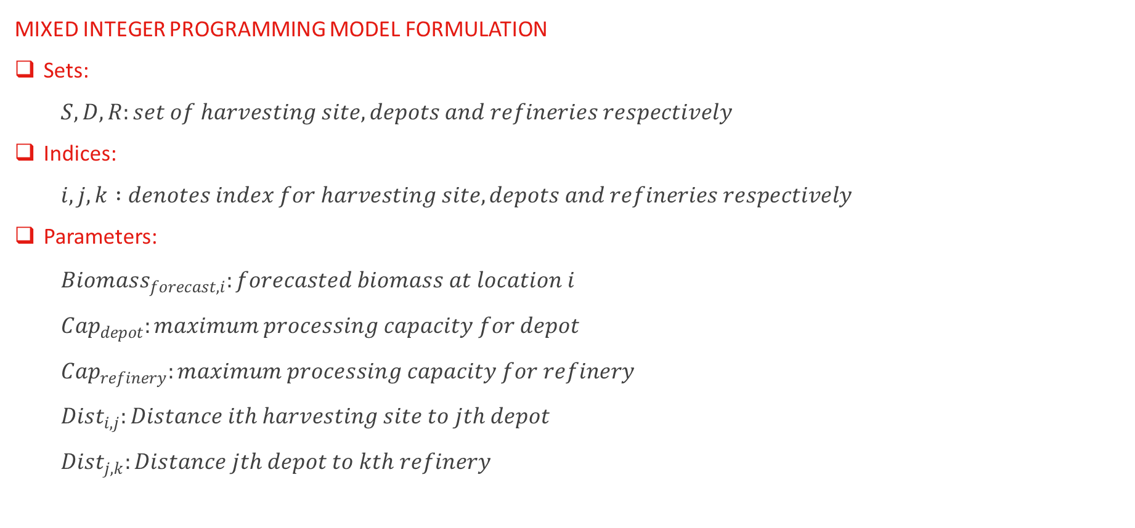
Problem Formulation
MIXED INTEGER PROGRAMMING MODEL FORMULATION
Sets:
$$S, D, R:set of harvesting site, depots and refineries respectively$$
Indices:
$$i, j, k :denotes index for harvesting site, depots and refineries respectively$$
Parameters:
$${Biomass}_{forecast,i}:forecasted biomass at location i$$
$${Cap}_{depot}:maximum processing capacity for depot$$
$${Cap}_{refinery}:maximum processing capacity for refinery$$
$${Dist}_{i,j}:Distance ith harvesting site to jth depot$$
$${Dist}_{j,k}:Distance jth depot to kth refinery$$

Slide 7
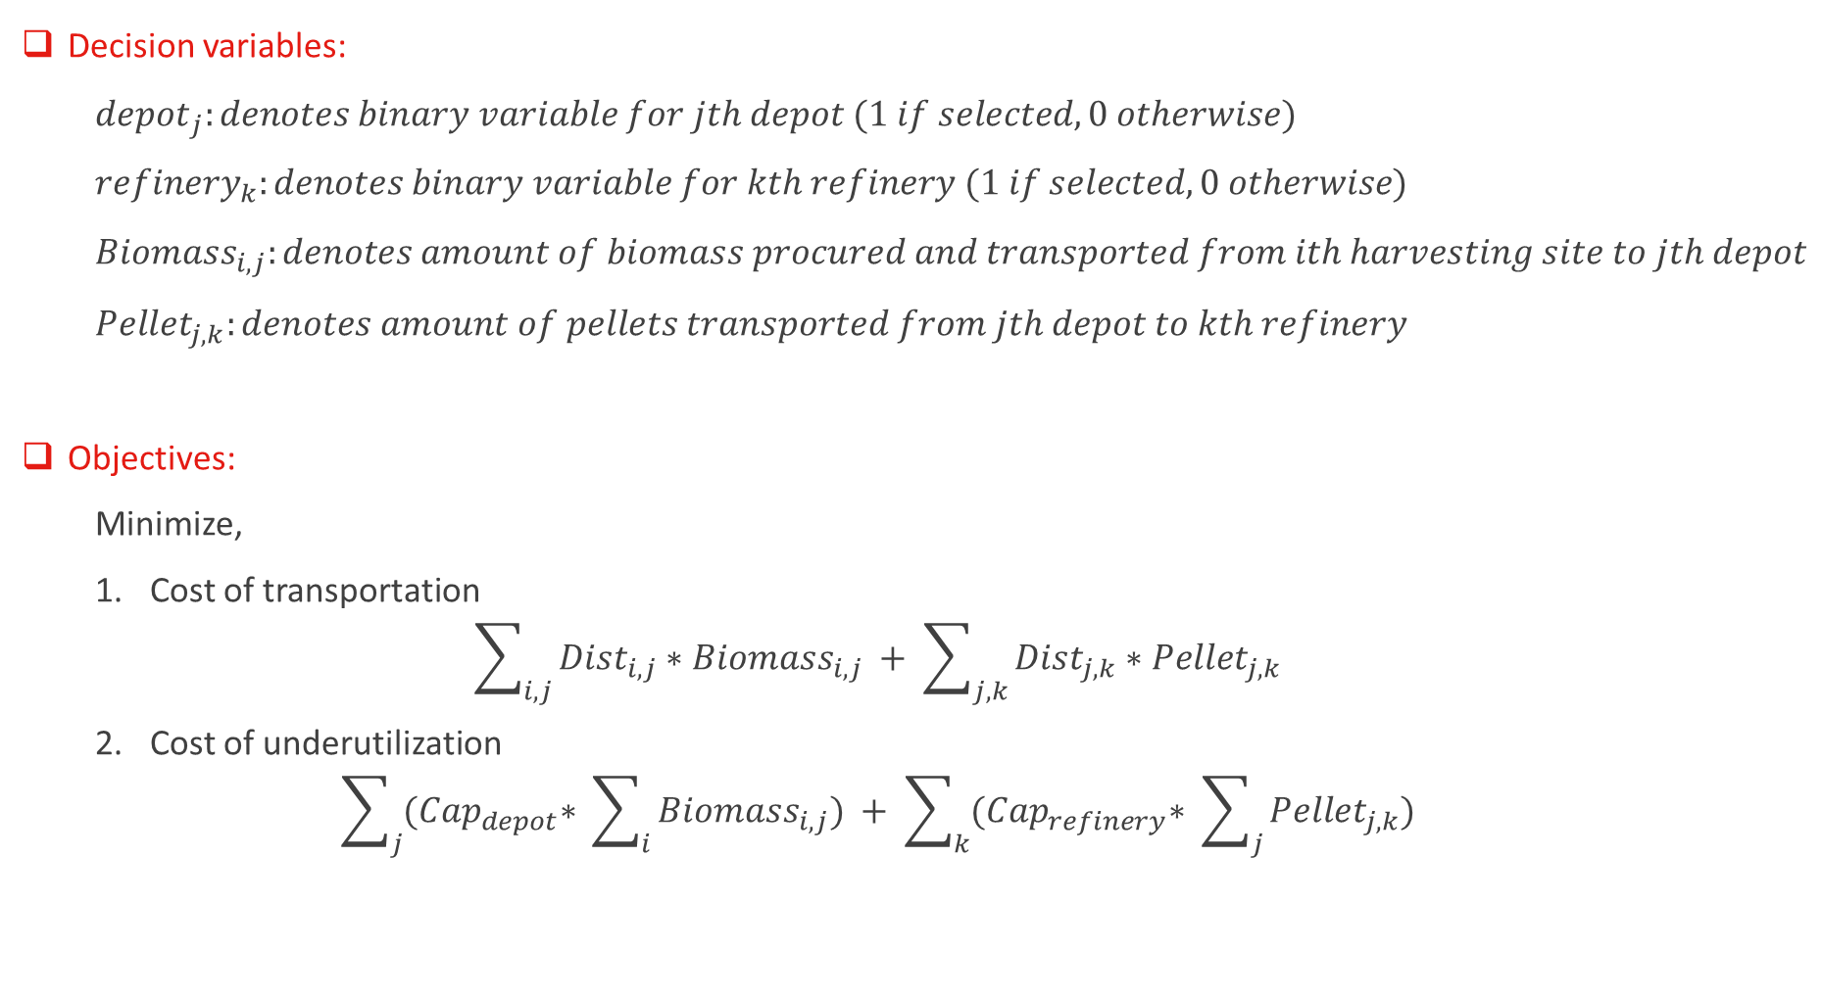
Problem Formulation (contd.)
Decision variables:
$${depot}_{j}:denotes binary variable for jth depot (1 if selected, 0 otherwise)$$
$${refinery}_{k}:denotes binary variable for kth refinery (1 if selected, 0 otherwise)$$
$${Biomass}_{i,j}:denotes amount of biomass procured and transported from ith harvesting site to jth depot$$
$${Pellet}_{j,k}:denotes amount of pellets transported from jth depot to kth refinery$$
Objectives:
Minimize,
Cost of transportation
$$\sum_{i,j}{{Dist}_{i,j}∗{Biomass}_{i,j}} + \sum_{j,k}{{Dist}_{j,k}∗{Pellet}_{j,k}}$$
Cost of underutilization
$$\sum_{j}{{(Cap}_{depot}∗ \sum_{i}{{Biomass}_{i,j}})} + \sum_{k}{{(Cap}_{refinery}∗ \sum_{j}{{Pellet}_{j,k}})}$$

Slide 8
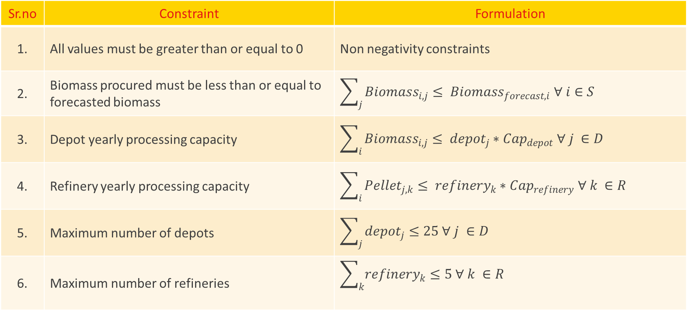
Problem Formulation (contd.)
Sr.no | Constraint | Formulation
1. | All values must be greater than or equal to 0 | Non negativity constraints
2. | Biomass procured must be less than or equal to forecasted biomass | $$\sum_{j}{{Biomass}_{i,j}}≤ {Biomass}_{forecast,i} ∀ i∈S$$
3. | Depot yearly processing capacity | $$\sum_{i}{{Biomass}_{i,j}}≤ {depot}_{j}∗{Cap}_{depot} ∀ j ∈D$$
4. | Refinery yearly processing capacity | $$\sum_{i}{{Pellet}_{j,k}}≤ {refinery}_{k}∗{Cap}_{refinery} ∀ k ∈R$$
5. | Maximum number of depots | $$\sum_{j}{{depot}_{j}}≤25 ∀ j ∈D$$
6. | Maximum number of refineries | $$\sum_{k}{{refinery}_{k}}≤5 ∀ k ∈R$$

Slide 9
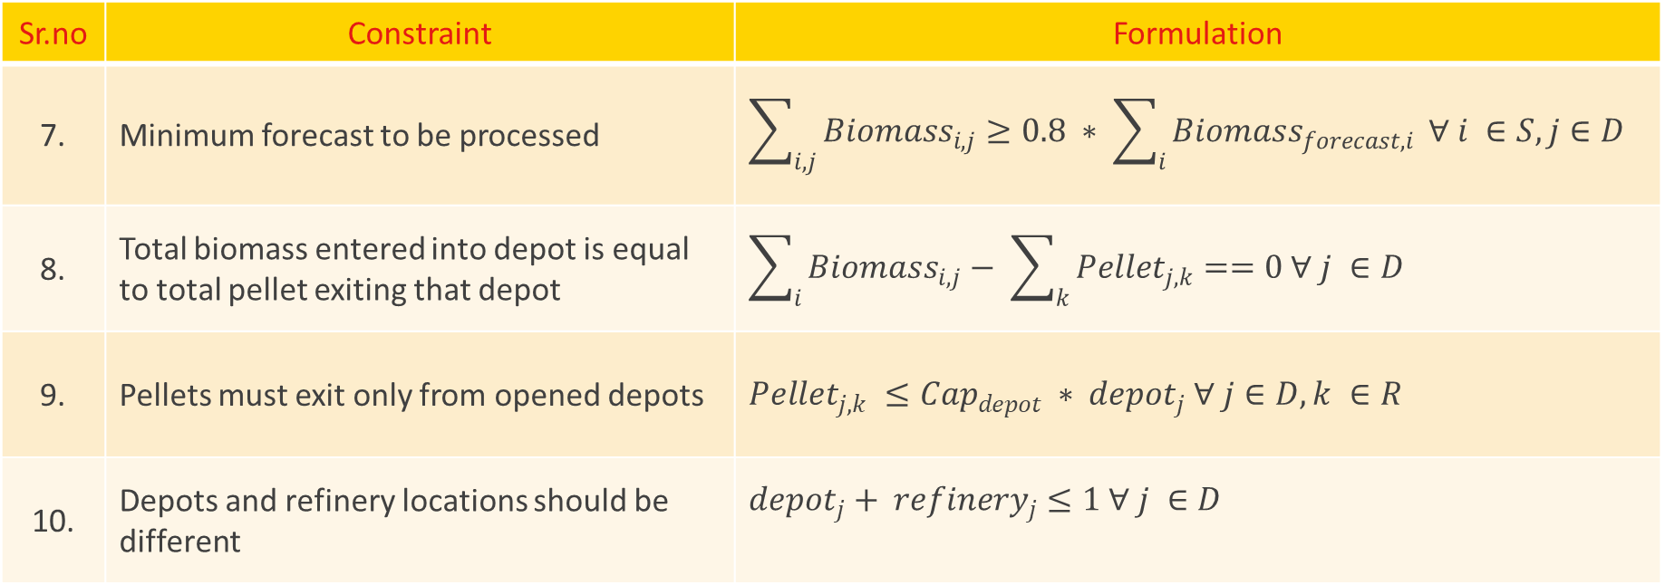
Problem Formulation (contd.)
Sr.no | Constraint | Formulation
7. | Minimum forecast to be processed | $$\sum_{i,j}{{Biomass}_{i,j}}≥0.8 ∗ \sum_{i}{{Biomass}_{forecast,i}} ∀ i ∈S, j∈D$$
8. | Total biomass entered into depot is equal to total pellet exiting that depot | $$\sum_{i}{{Biomass}_{i,j}}− \sum_{k}{{Pellet}_{j,k}}==0 ∀ j ∈D$$
9. | Pellets must exit only from opened depots | $${Pellet}_{j,k} ≤{Cap}_{depot} ∗ {depot}_{j} ∀ j∈D, k ∈R$$
10. | Depots and refinery locations should be different | $${depot}_{j}+ {refinery}_{j}≤1 ∀ j ∈D$$
Note:
Constraint 9 and 10 are added as extra constraints in model to have practical results.

Slide 10
Results Achieved
 | Time series forecasting | Facility location using MIP | Supply chain network using MIP
Results Accuracy (Score) For 2018 : 81.55 For 2019 : 78.22 | MAPE with real values For ARIMA: For 2018 : 51.41 For 2019 : 72.72 For FB Prophet: For 2018 : 50.73 For 2019 : 34.66 | Number of depots selected - 15 Number of refineries selected - 3 | Total Biomass Procured: For 2018 : 85 % For 2019 : 97 % Cost of transportation For 2018 : 35071726 For 2019 : 37478927 Cost of underutilization For 2018 & 2019 : 0 (All depots and refineries are completely utilized)
Performance details | Training time : ~ 30 mins | Model run time: For a single year : ~ 5 mins (With 100 clusters) | Model run time: For a single year : ~ 2 secs

Slide 11
Innovation

Slide 12
INNOVATION
Model related Innovation
Practical considerations in model
Trained different time series models on biomass production dataset and compared best model for forecasting. Training different models can help in deploying framework for different sites.
Added extra constraint to select depot and refineries at different locations. This improved bounds on model.
Performance related Innovation
Reduced overall model size (decision variables, constraints, etc.) in stage 1
Use of clustering to group sites and consider each cluster as single site. This scaled down overall supply chain network decisions and helped to solve model in reasonable time.
Fixed depots and refineries locations in complete supply chain network (Stage 2)
Results of stage 1 i.e. depot and refinery locations were fixed to solve every years supply chain network problem. This reduced problem to only decide on harvesting site allocation to depots and depots allocation to refineries.

Slide 13
Deployment & Scalability

Slide 14
Deployment and Scalability
Computational Infrastructure
Applications like PyCharm for development and Jupyter notebook for visualization purpose
Python with time series forecasting libraries and dedicated operation research solver like gurobi/cplex, etc. to optimize large problems
Database management system (e.g. SQL) may be required to manage data inputs and outputs
High performance computer to carry out forecast and optimization tasks for large dataset. Cloud platform like AWS or Azure may also help for scalability.

Slide 15
Deployment and Scalability (contd.)
Deployments for other sites
Solution framework is generalized and can be used directly for deployments at different sites. Steps to deploy can be followed as below,
Data collection for biomass production at different regions of site. If cloud infrastructure used, model can be deployed on cloud system and can be accessed for different sites.
Train different time series forecasting models for a site and select suitable model for prediction. It depends on historical time series data and can decide forecasting model to be used for prediction.
Decide suitable number of clusters which captures correct biomass production distribution for a site and

Slide 16
Deployment and Scalability (contd.)
IP strategy
Product IP’s : Solution framework, Development source code and parameter selection methods
Detailed documentation, recording results. It can be vital in proving ownership in case of IP disputes
Trademark for product on team name as product can be used for different sites
Encrypting data and model while engaging with other tools or data sources
Establishing clear agreements for ownership, rights and support of product

